Slide 1
Automatic Bridge Bidding Using Deep Reinforcement Learning
Chih-Kuan Yeh, Cheng-Yu Hsieh , and Hsuan-Tien Lin
IEEE TRANSACTIONS ON GAMES, VOL. 10, NO. 4, DECEMBER 2018
Presenter: Ying-Yu Lin
Date: Mar.8, 2022

Slide 2
Abstract (1/2)
Bridge is among the zero-sum games for which artificial intelligence has not yet outperformed expert human players. The main difficulty lies in the bidding phase of bridge, which requires cooperative decision making with partial information. Existing artificial intelligence systems for bridge bidding rely on, and are thus restricted by, human-designed bidding systems or features. In this work, we propose a flexible and pioneering bridge-bidding system, which can learn either with or without the aid of human domain knowledge. The system is based on a novel deep reinforcement learning model, which extracts sophisticated features and learns to bid automatically based on raw card data. The model includes an upper-confidence-bound algorithm and additional techniques to achieve a balance between exploration and exploitation

Slide 3
Abstract (2/2)
We further study how different pieces of human knowledge can be exploited to assist the model. Our experiments demonstrate the promising performance of our proposed model. In particular, the model can advance from having no knowledge on bidding to achieving a superior performance compared with a champion-winning computer bridge program that implements a human-designed bidding system. In addition, further synergies can be extracted by incorporating expert knowledge into the proposed model.

Slide 4
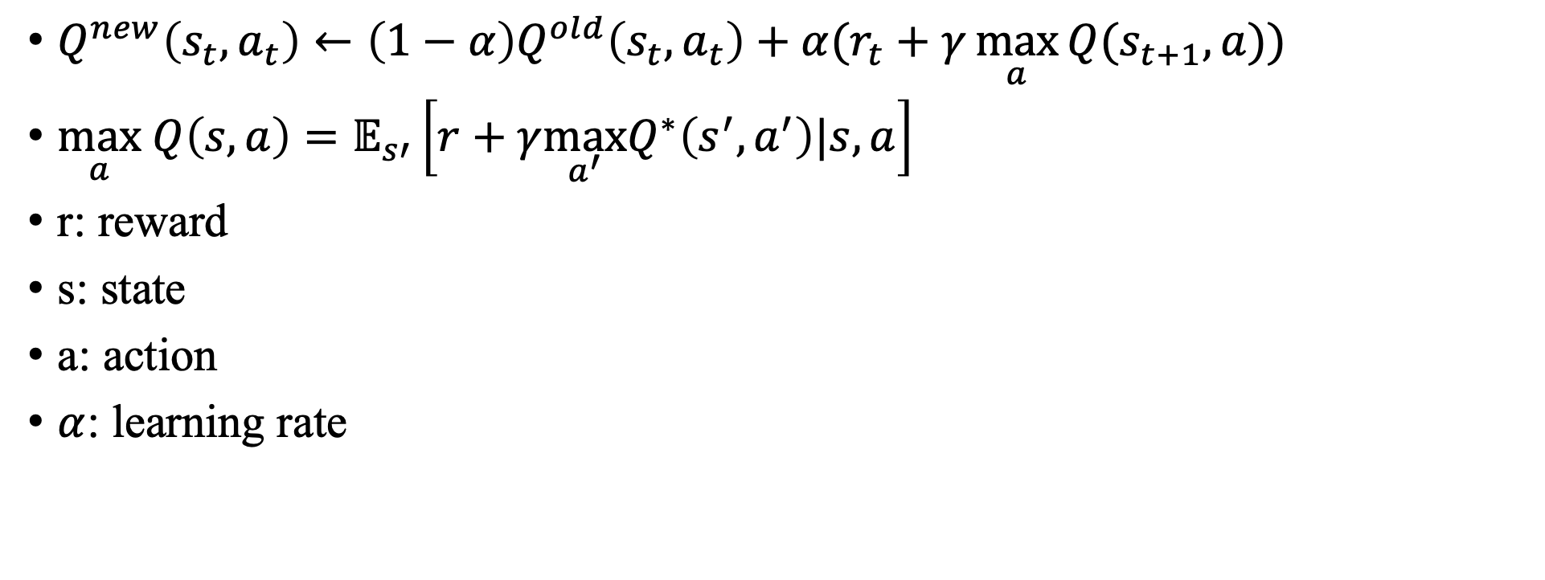
Q Learning
$Q^{new}\left(s_{t},a_{t}\right)←\left(1−α\right)Q^{old}\left(s_{t},a_{t}\right)+α(r_{t}+γ\max_{a}{Q(s_{t+1},a)})$
$\max_{a} Q\left(s,a\right)=𝔼_{s′}\left[r+γ\max_{a^{′}}Q^{∗}\left(s^{′},a^{′}\right)|s,a\right]$
r: reward
s: state
a: action
$α$: learning rate

Slide 5
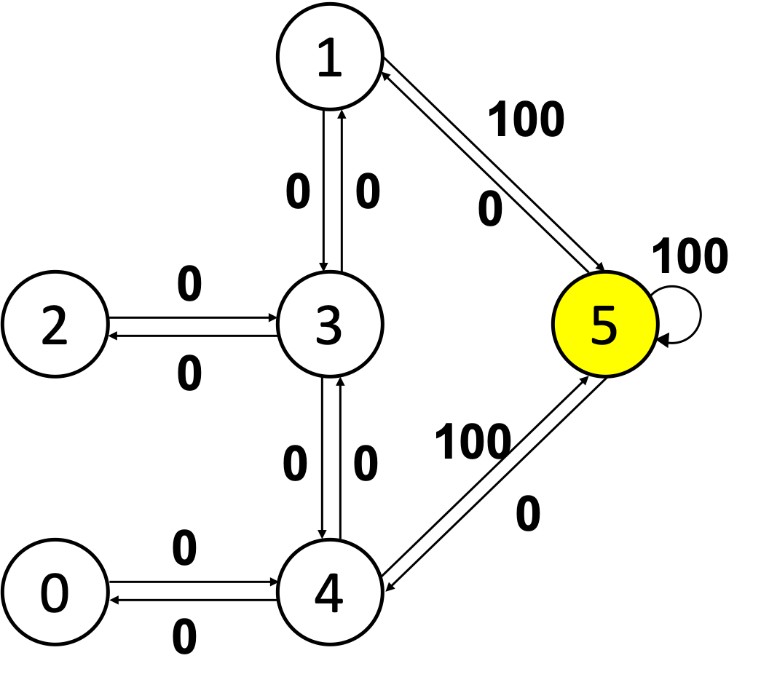
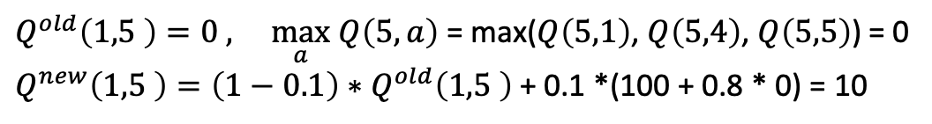


$$Q^{new}\left(s_{t},a_{t}\right)←\left(1−α\right)Q^{old}\left(s_{t},a_{t}\right)+α(r_{t}+γ\max_{a}{Q(s_{t+1},a)})$$
Q Learning
$$\max_{a} Q\left(s,a\right)=𝔼_{s′}\left[r+γ\max_{a^{′}}Q^{∗}\left(s^{′},a^{′}\right)|s,a\right]$$
$assume α$ = 0.1 , $γ$ = 0.8
 | 0 | 1 | 2 | 3 | 4 | 5
0 | 0 | 0 | 0 | 0 | 0 | 0
1 | 0 | 0 | 0 | 0 | 0 | 0
2 | 0 | 0 | 0 | 0 | 0 | 0
3 | 0 | 0 | 0 | 0 | 0 | 0
4 | 0 | 0 | 0 | 0 | 0 | 0
5 | 0 | 0 | 0 | 0 | 0 | 0
$Q^{old}\left(1,5 \right)=0 ,$ $\max_{a} Q\left(5,a\right)$ = max($Q\left(5,1\right)$, $Q\left(5,4\right)$, $Q\left(5,5\right)$) = 0
$Q^{new}\left(1,5 \right)=\left(1−0.1\right)∗$ $Q^{old}\left(1,5 \right)$ + 0.1 *(100 + 0.8 * 0) = 10

Slide 6
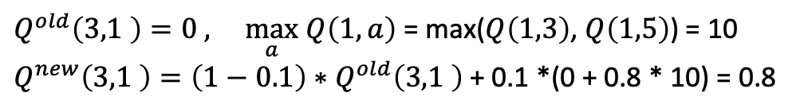
$$Q^{new}\left(s_{t},a_{t}\right)←\left(1−α\right)Q^{old}\left(s_{t},a_{t}\right)+α(r_{t}+γ\max_{a}{Q(s_{t+1},a)})$$
Q Learning
$$\max_{a} Q\left(s,a\right)=𝔼_{s′}\left[r+γ\max_{a^{′}}Q^{∗}\left(s^{′},a^{′}\right)|s,a\right]$$
$assume α$ = 0.1 , $γ$ = 0.8
 | 0 | 1 | 2 | 3 | 4 | 5
0 | 0 | 0 | 0 | 0 | 0 | 0
1 | 0 | 0 | 0 | 0 | 0 | 10
2 | 0 | 0 | 0 | 0 | 0 | 0
3 | 0 | 0 | 0 | 0 | 0 | 0
4 | 0 | 0 | 0 | 0 | 0 | 0
5 | 0 | 0 | 0 | 0 | 0 | 0
$Q^{old}\left(3,1 \right)=0 ,$ $\max_{a} Q\left(1,a\right)$ = max($Q\left(1,3\right)$, $Q\left(1,5\right)$) = 10
$Q^{new}\left(3,1 \right)=\left(1−0.1\right)∗$ $Q^{old}\left(3,1 \right)$ + 0.1 *(0 + 0.8 * 10) = 0.8

Slide 7
$$Q^{new}\left(s_{t},a_{t}\right)←\left(1−α\right)Q^{old}\left(s_{t},a_{t}\right)+α(r_{t}+γ\max_{a}{Q(s_{t+1},a)})$$
Q Learning
$$\max_{a} Q\left(s,a\right)=𝔼_{s′}\left[r+γ\max_{a^{′}}Q^{∗}\left(s^{′},a^{′}\right)|s,a\right]$$
$assume α$ = 0.1 , $γ$ = 0.8
 | 0 | 1 | 2 | 3 | 4 | 5
0 | 0 | 0 | 0 | 0 | 0 | 0
1 | 0 | 0 | 0 | 0 | 0 | 10
2 | 0 | 0 | 0 | 0 | 0 | 0
3 | 0 | 0.8 | 0 | 0 | 0 | 0
4 | 0 | 0 | 0 | 0 | 0 | 0
5 | 0 | 0 | 0 | 0 | 0 | 0
$Q^{old}\left(3,1 \right)=0 ,$ $\max_{a} Q\left(1,a\right)$ = max($Q\left(1,3\right)$, $Q\left(1,5\right)$) = 10
$Q^{new}\left(3,1 \right)=\left(1−0.1\right)∗$ $Q^{old}\left(3,1 \right)$ + 0.1 *(0 + 0.8 * 10) = 0.8

Slide 8
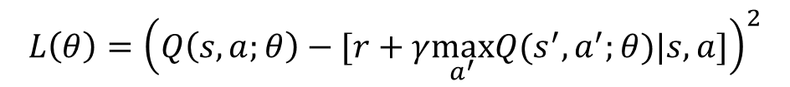
Architecture of the Q-function of the bidding problem
52-dimension raw data of Player1’ s hand
Extra 36-dimension describing the bidding history
Fully connected layers with 128 neurons
Fully connected layers with 128 neurons
$$L\left(θ\right)={\left(Q\left(s,a;θ\right)−[r+γ\max_{a^{′}}Q(s^{′},a^{′};θ)|s,a]\right)}^{2}$$
Fully connected layers with 128 neurons
36-dimension output for the cost

Slide 9
Structure of our bridge-bidding framework
min
Hand of player1
Hand of player2
Bid1
DNN layer 1
Output layer
Bid2
DNN layer 2
Output layer
Continue until PASS occurs
DNN layer 3

Slide 10

Exploration methods
$ε$-greedy: $a^{(t)}=\left\{\begin{aligned}\max_{a^{t}}{Q\left(s^{t},a^{t}\right)}, x>1−ε \\ randomly choose, otherwise\end{aligned}\right.$
UCB1: $a^{(t)}=\max_{a^{t}}{[Q\left(s^{t},a^{t}\right)+α\sqrt{\frac{2\ln{T}}{T_{a}}}]}$

Slide 11
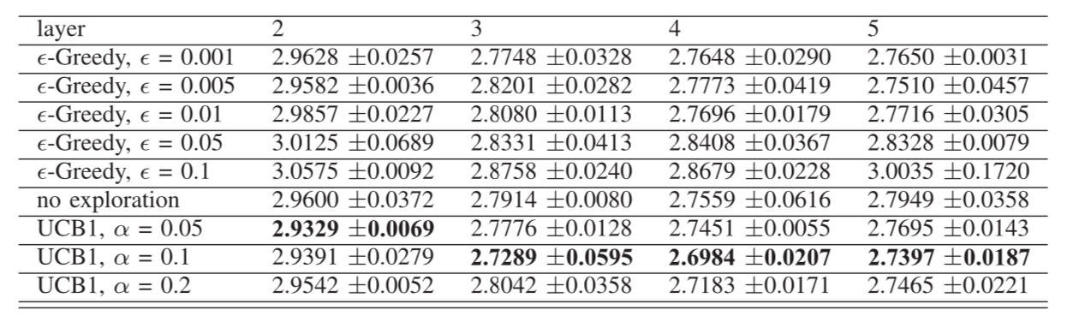
Exploration methods
comparisons between the average cost of two exploration methods
where different values of parameter in each exploration method is tested

Slide 12
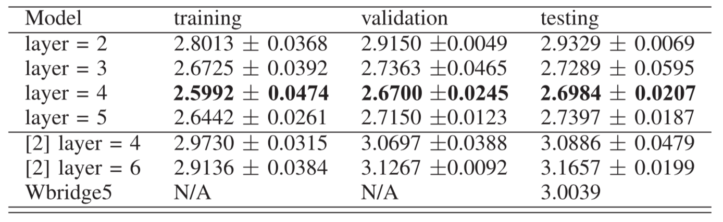

Architecture of the Q-function of the bidding problem
$cost vector c\left(a\right)=(c\left(a\right)′−\min_{a^{′}}{c\left(a\right)′})/25$
Reward $R\left(a\right)=1 −c(a)$
comparison of the average cost for our models, those in [2], and Wbridge5

